Slide 1
Opinion Formation
Comparing Different Models
DJ Lav
Lukas Keller, Duy Lai, Javier Naya, Valentyna Pavliv and Agnese Sacchi

Slide 2
Outline
Introduction
Classical Model
Bounded Confidence Model
Co-evolution Network
Discussion and Conclusion

Slide 3
Introduction - Opinion Dynamics
Presented models: Classical Model, Bounded Confidence Model and Co-evolution Network
How to reach consensus?
How to model clustering and bi-polarization?
What are the links between these models?

Slide 4
Outline
Introduction
Classical Model
Bounded Confidence Model
Co-evolution Network
Discussion and Conclusion

Slide 5
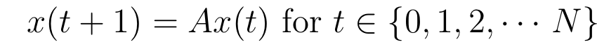
Classical Model - Background Equation
x(t): Vector of Opinions at time t
A: Stochastic matrix of connection between people

Slide 6
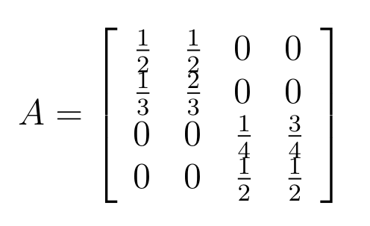
Communities Modelisation
Particularity of the matrix
What happens if we add a link (celebrity) between communities?

Slide 7

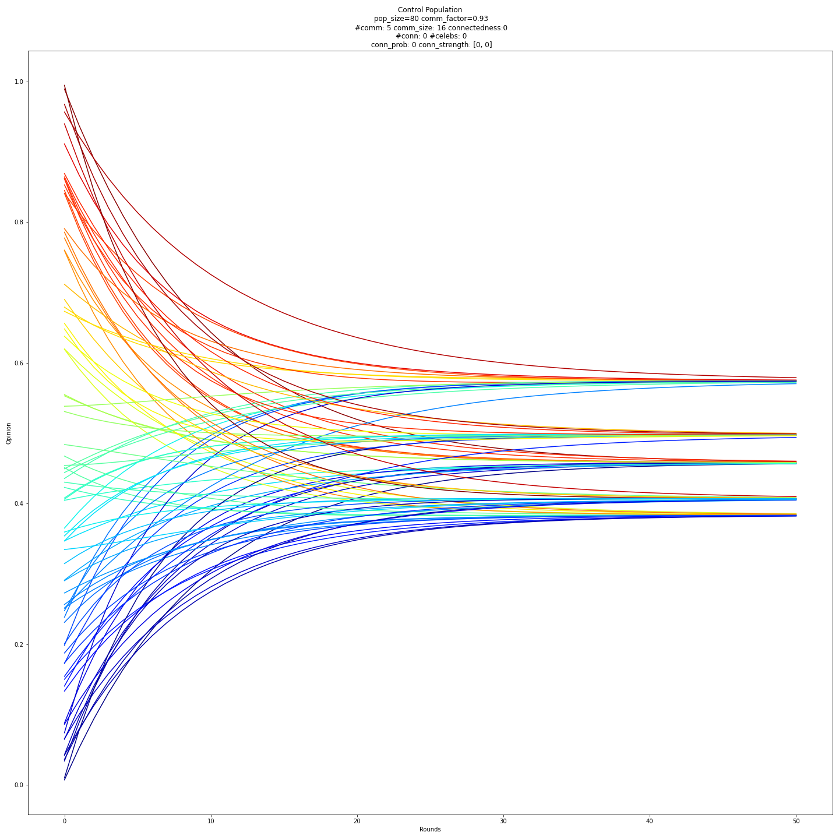
Simulation - Control
Opinions
Time

Slide 8
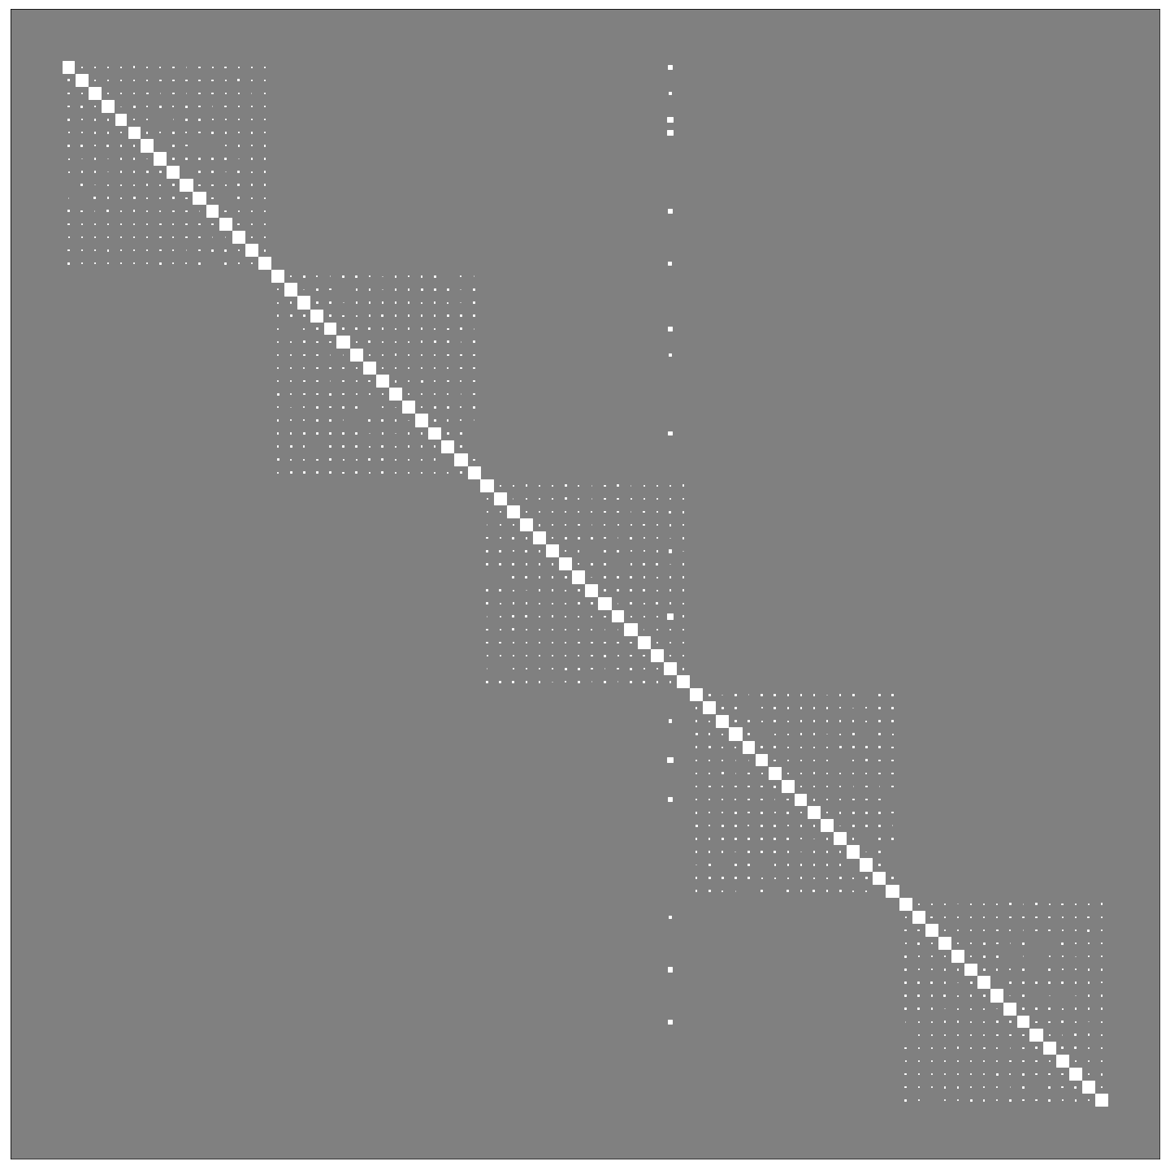
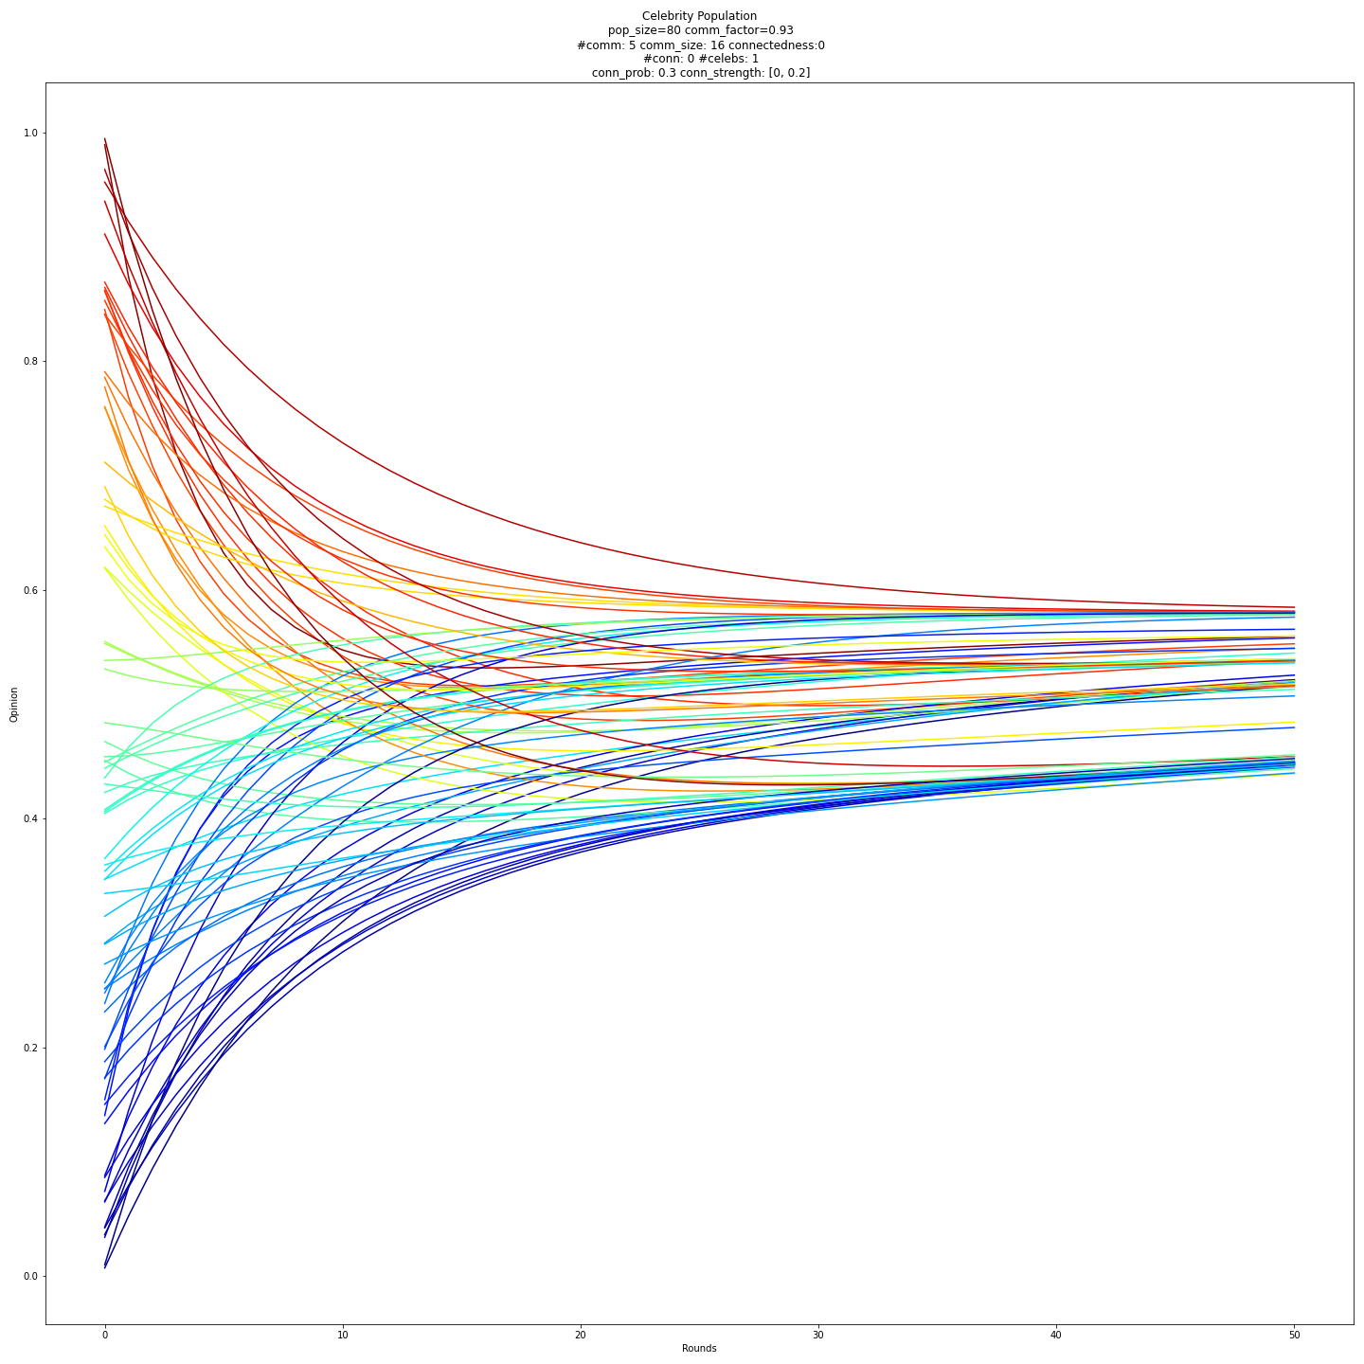
Simulation - 1 celebrity
Opinions
Time

Slide 9
Comparison - Control VS 1 celebrity
Control
With 1 celebrity
Opinions
Opinions
Time
Time

Slide 10
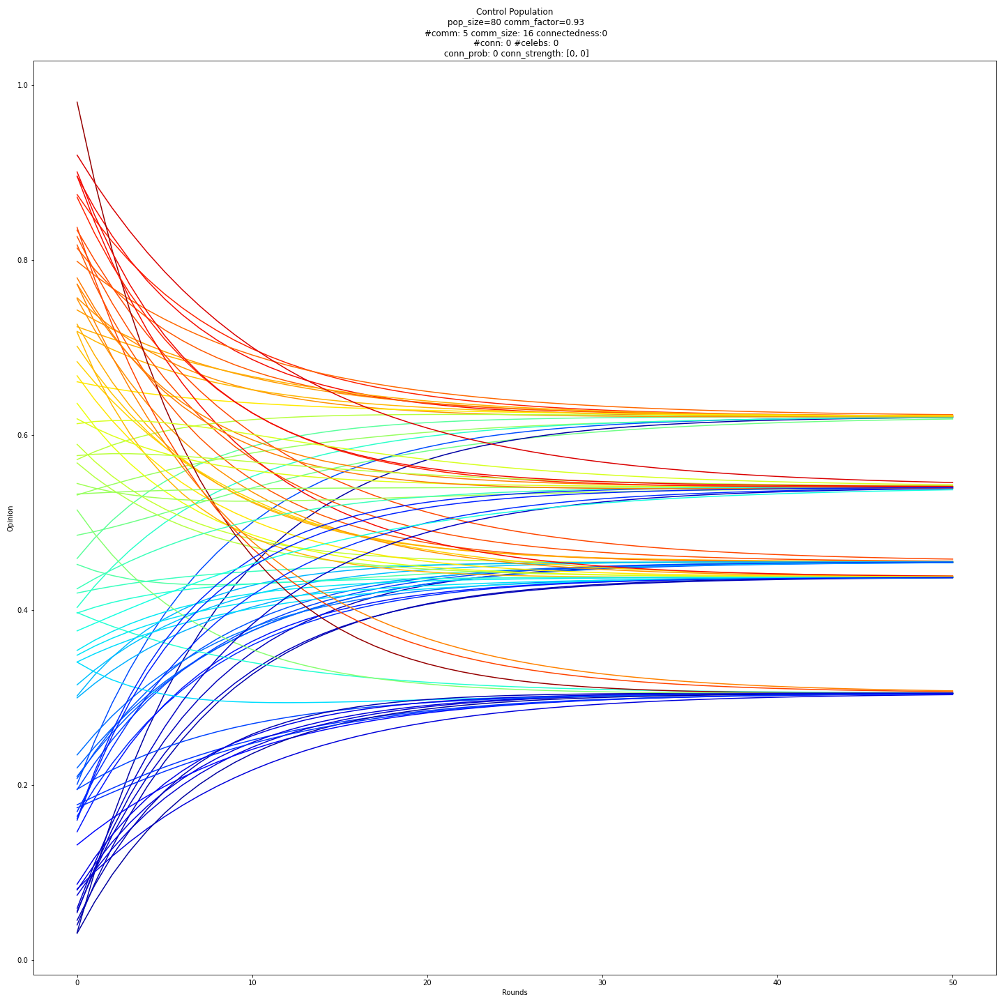
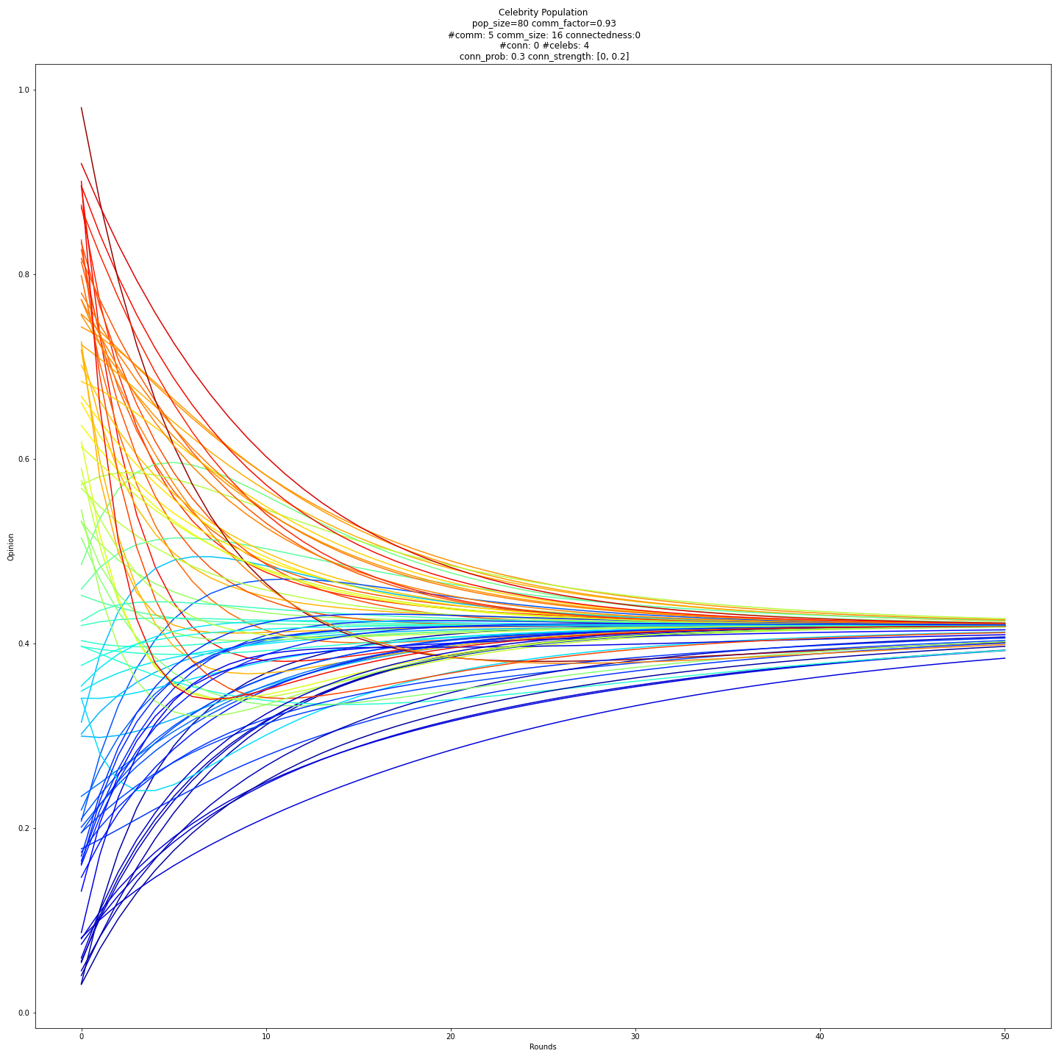
Comparison - Control VS 4 celebrities
Control
With 4 celebrities
Opinions
Opinions
Time
Time

Slide 11
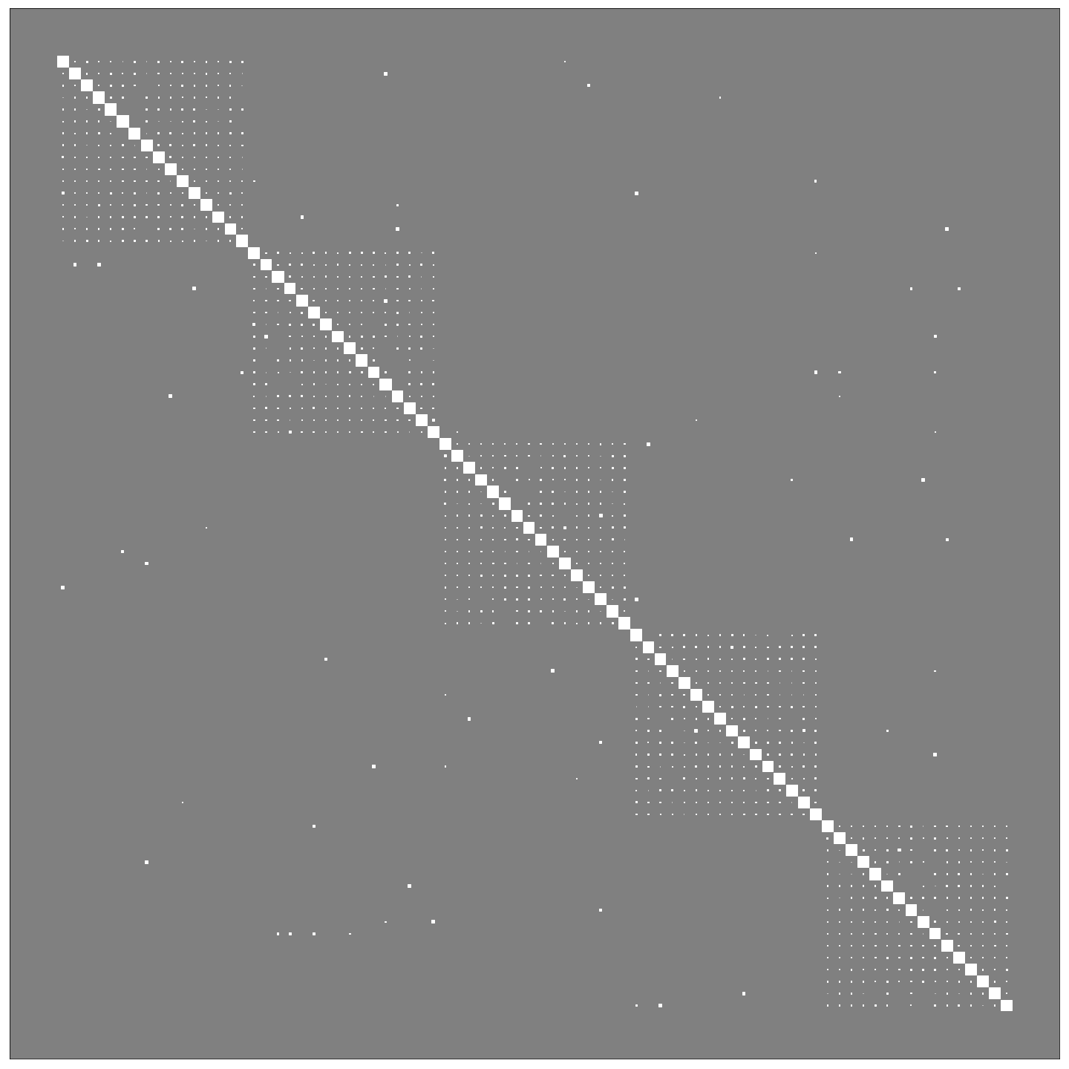
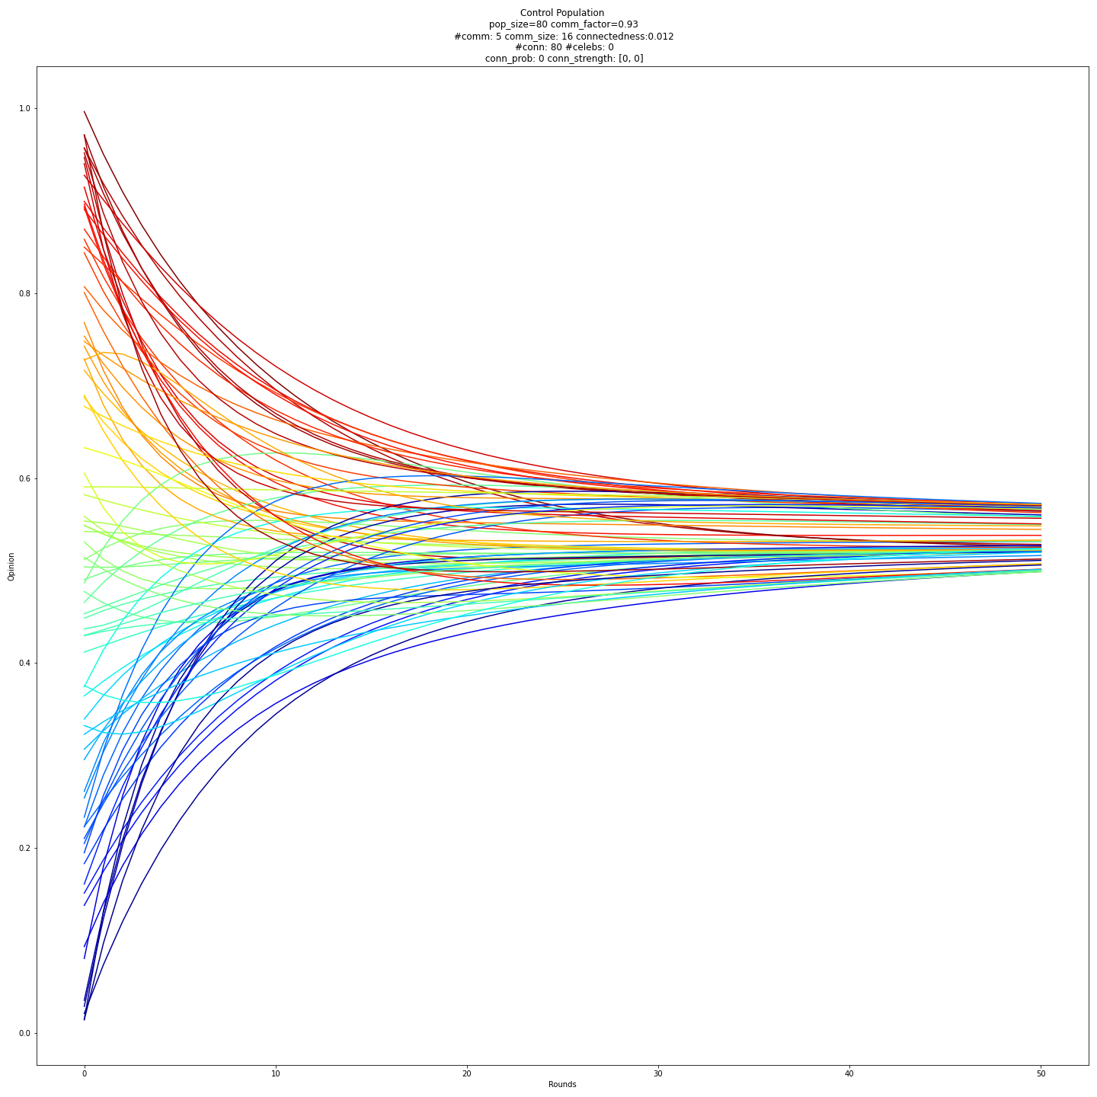
Simulation - More connections
Opinions
Time

Slide 12
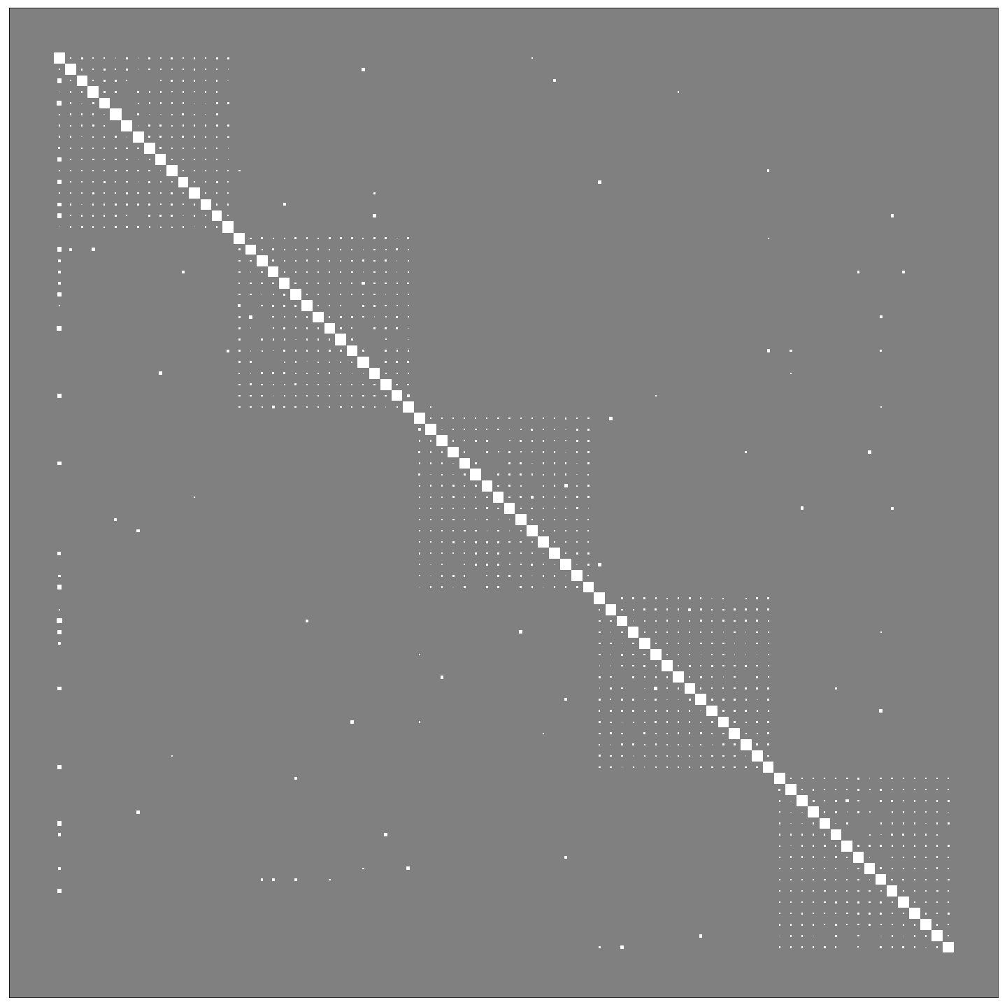
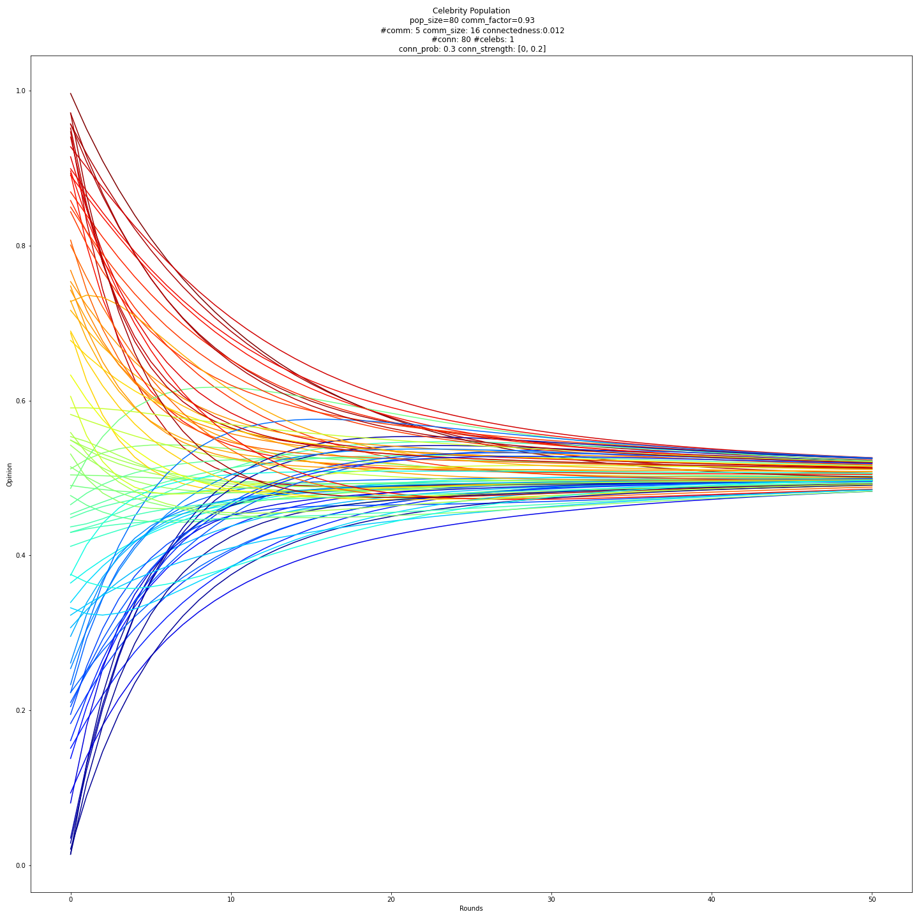
Simulation - More connections and 1 celebrity
Opinions
Time

Slide 13
Comparison - More connections
Control
With 1 celebrity
Opinions
Opinions
Time
Time

Slide 14
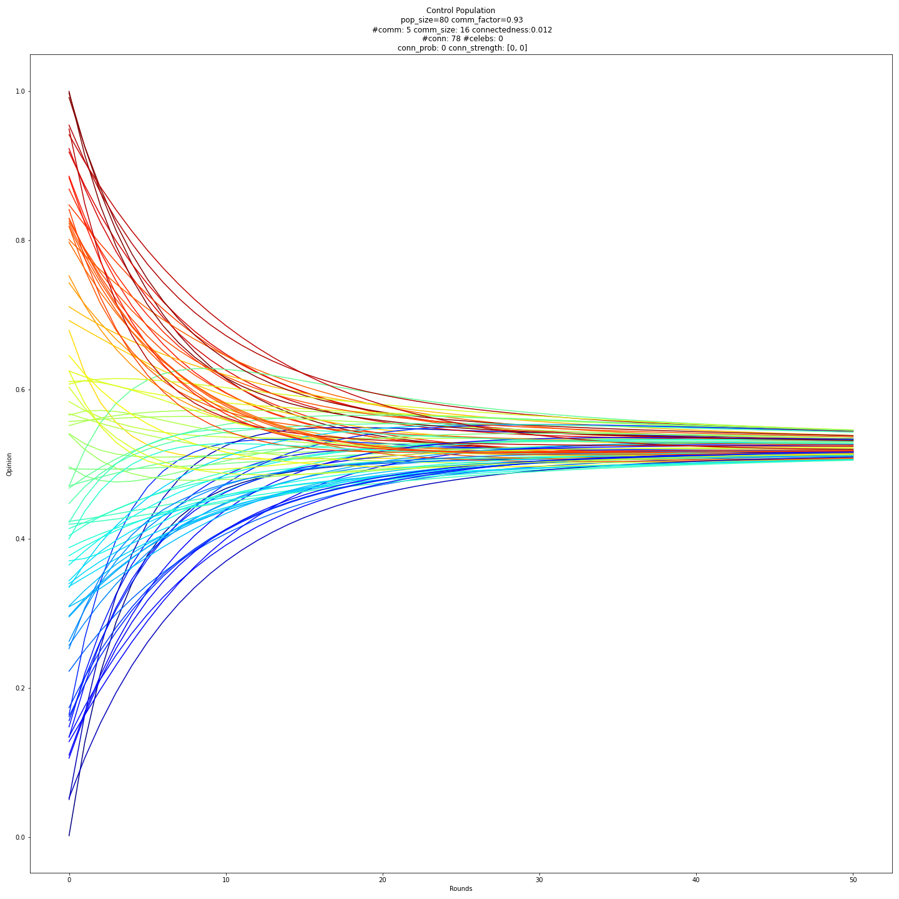
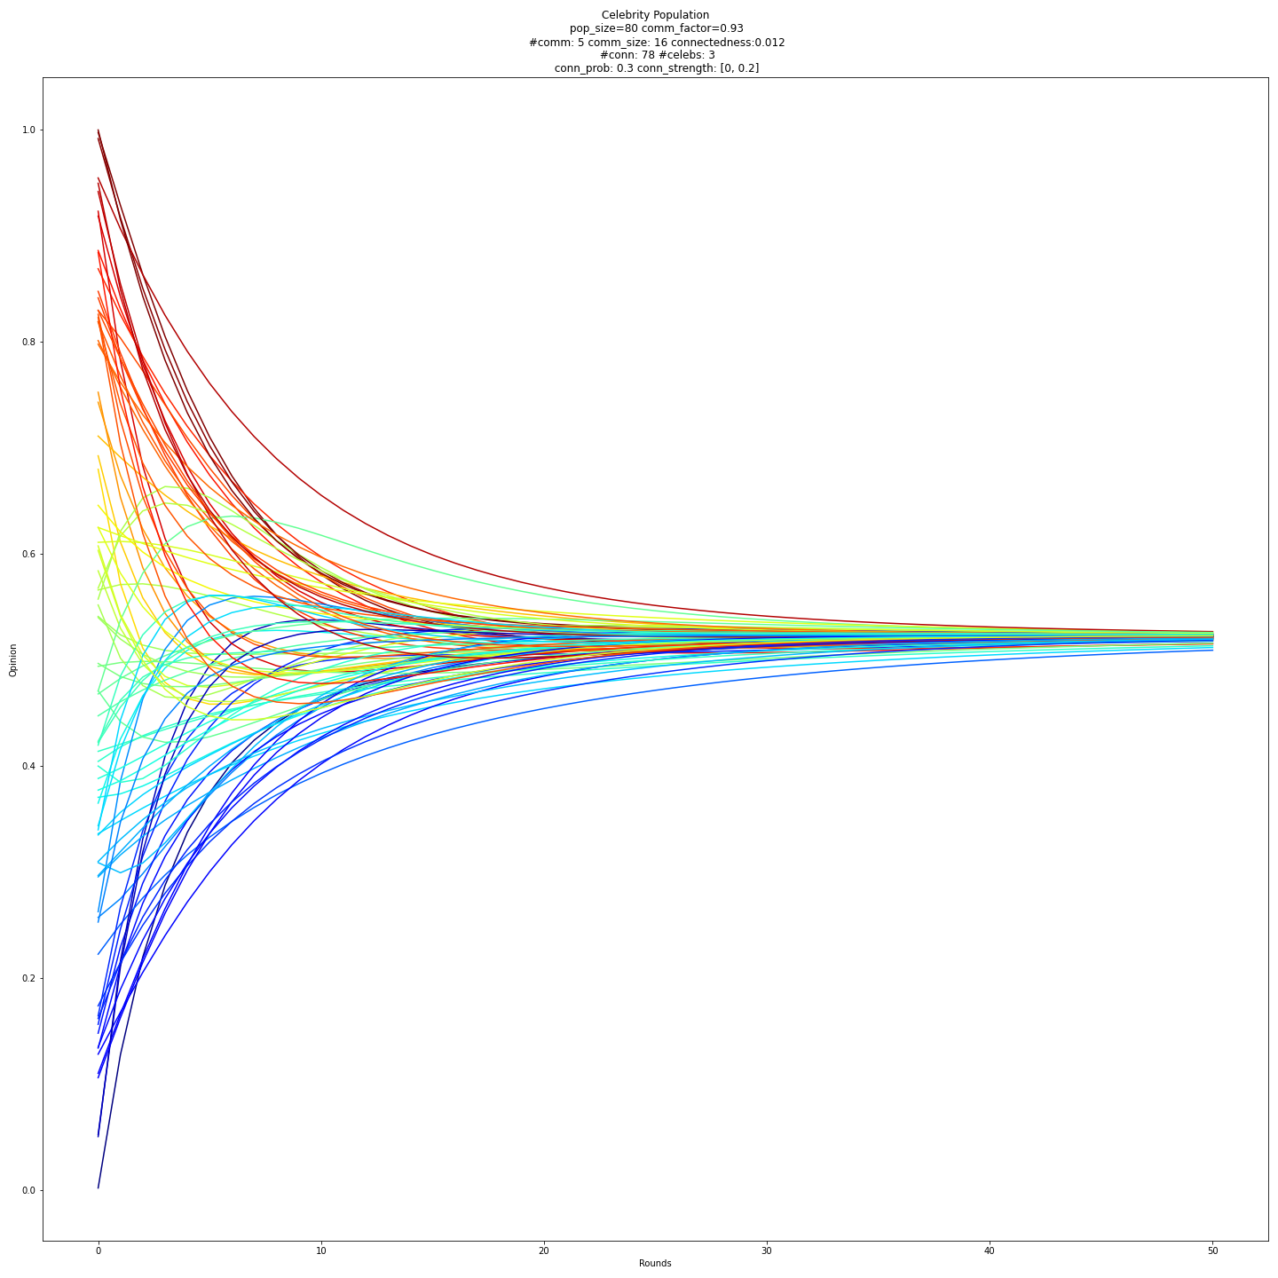
Comparison - More connections
Control
With 3 celebrities
Opinions
Opinions
Time
Time

Slide 15
Outline
Introduction
Classical Model
Bounded Confidence Model
Co-evolution Network
Discussion and Conclusion

Slide 16




Confidence Interval
0
1
A

Slide 17

Confidence Interval
0
1
B

Slide 18
Types of interval
Symmetric and uniform
Asymmetric and uniform
Opinion dependent asymmetry
[-ℇ, ℇ]
[-ℇ_{l} , ℇ_{r}]

Slide 19
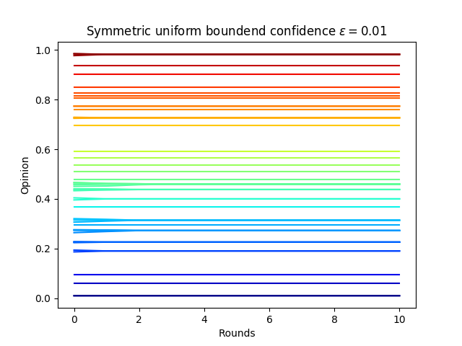
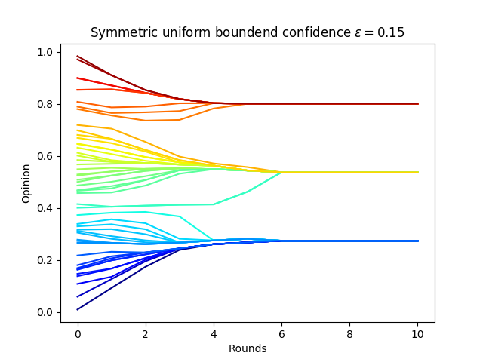
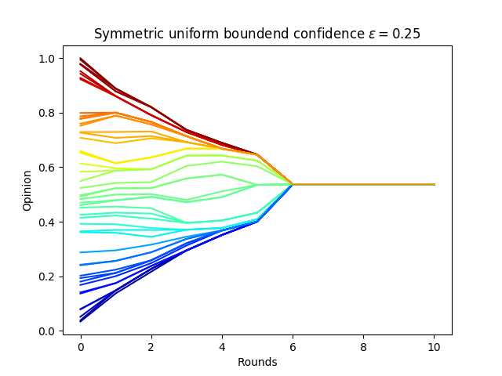
Simulation - symmetric and uniform [-ℇ, ℇ]
Population of 50

Slide 20
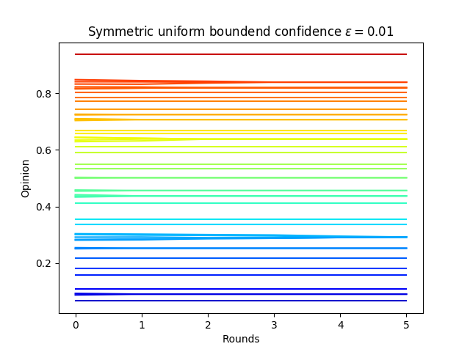
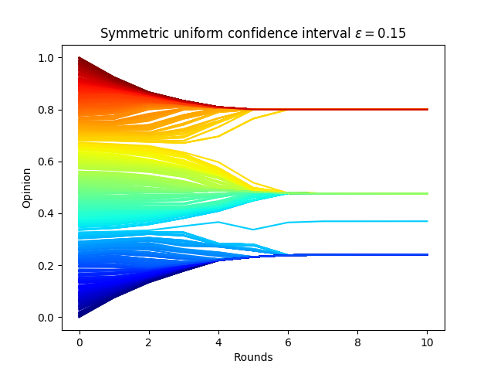
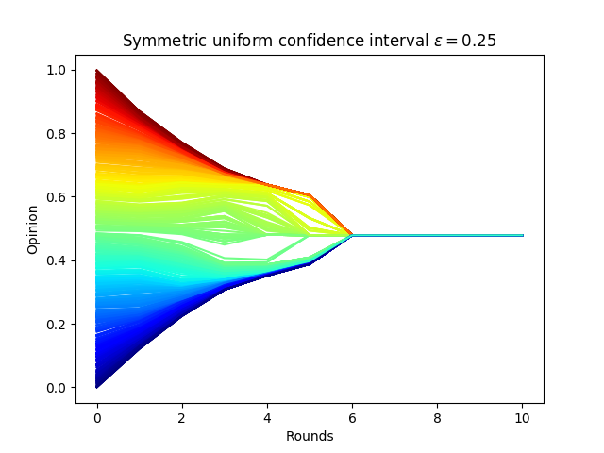
Simulation - symmetric and uniform [-ℇ, ℇ]
Population of 625

Slide 21
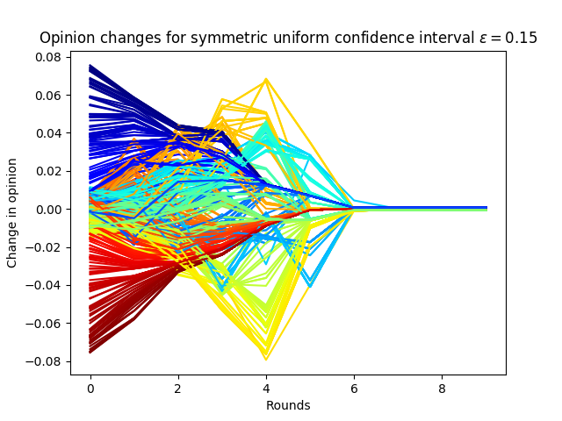
Change in opinion

Slide 22
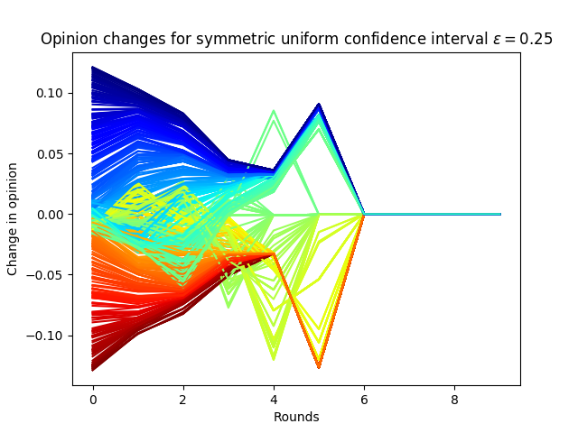
Change in opinion

Slide 23
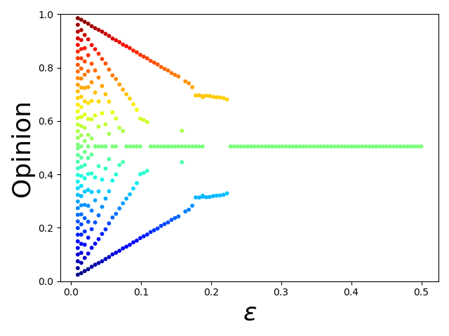
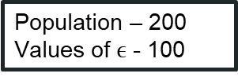
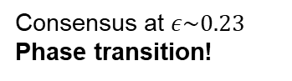
Bifurcation - Symmetric and Uniform
Clustering of many final opinions
Few clusters of final opinions
Consensus at $ε\sim 0.23$
Phase transition!
Population – 200
Values of $ϵ$ - 100

Slide 24
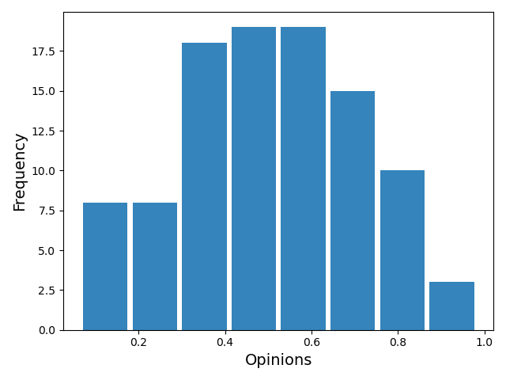
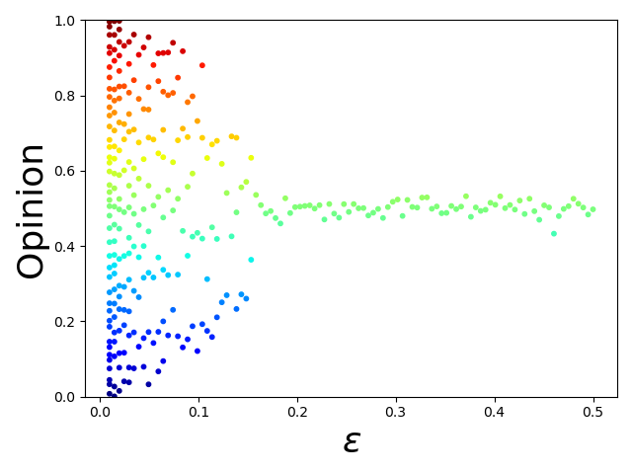
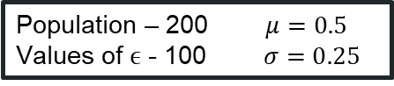
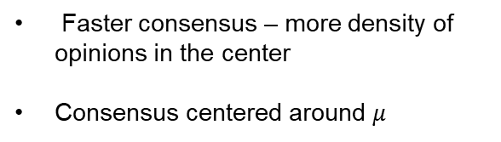
Bifurcation - Symmetric and Normal
How robust is the model
In real life opinions are not uniformly distributed
Truncated Normal Distribution
Faster consensus – more density of opinions in the center
Consensus centered around $μ$
Population – 200 $μ=0.5$
Values of $ϵ$ - 100 $σ=0.25$

Slide 25
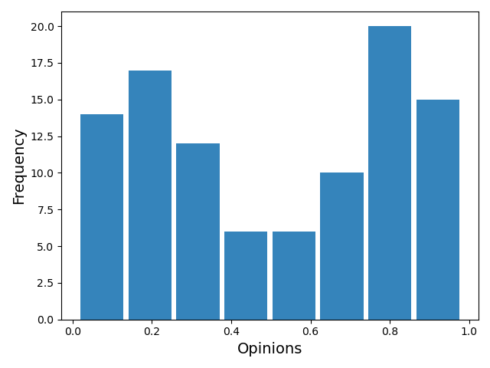
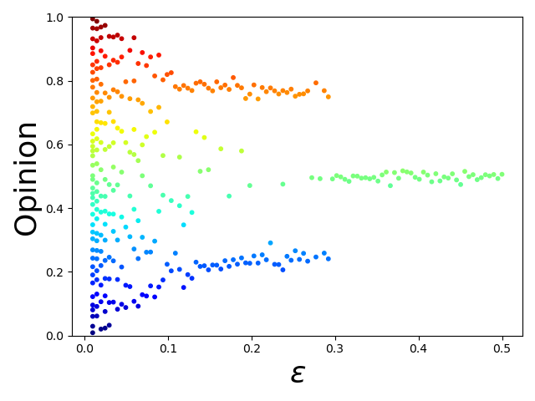
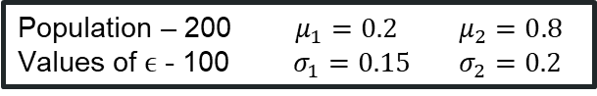
Bifurcation - Symmetric and Bimodal Normal
What happens if there already exists polarization?
Bimodal Normal Distribution
Clear polarization, even with fluctuations
Longer until consensus is reached
Population – 200 $μ_{1}=0.2$ $μ_{2}=0.8$
Values of $ϵ$ - 100 $σ_{1}=0.15$ $σ_{2}=0.2$

Slide 26
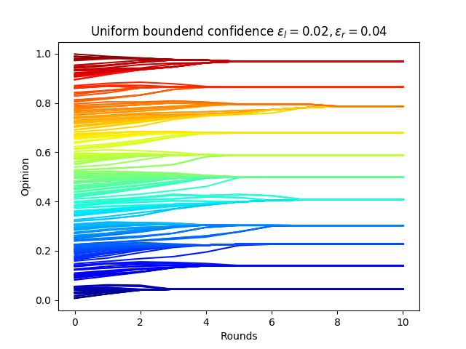
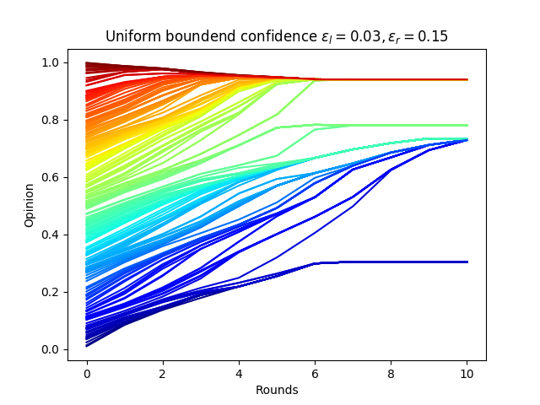
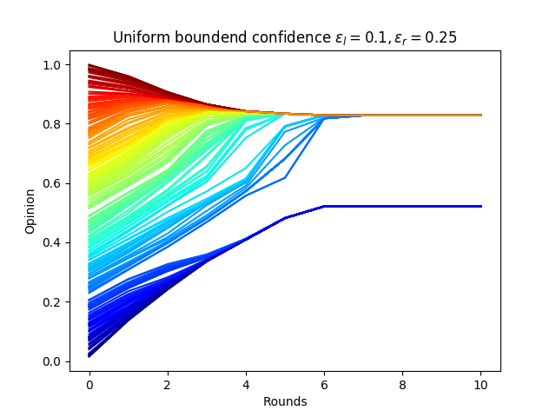
Simulation - asymmetric and uniform [-ℇ_{l} , ℇ_{r}]
ℇl = 0.02 , ℇr = 0.04
ℇl = 0.03 , ℇr = 0.15
ℇl = 0.1 , ℇr = 0.25

Slide 27
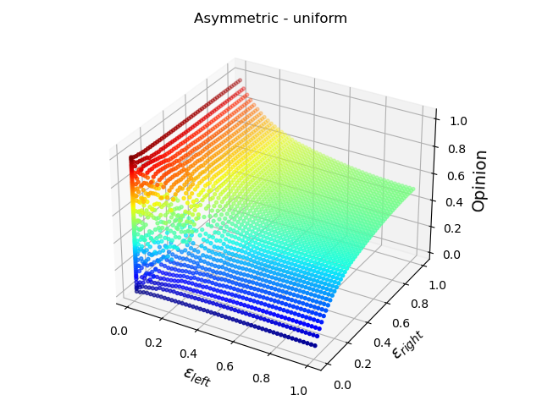
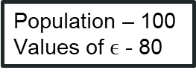
Bifurcation - Asymmetric and Uniform
Extreme opinions decrease fast if you extend your opposite confidence interval
Transitions appears to be more smooth
Population – 100
Values of $ϵ$ - 80

Slide 28
Opinion dependent asymmetry
2 variable parameters:
Total confidence interval, ⋶
Strength of the bias, m

Slide 29
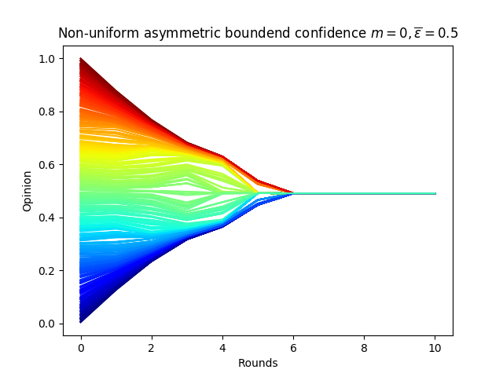
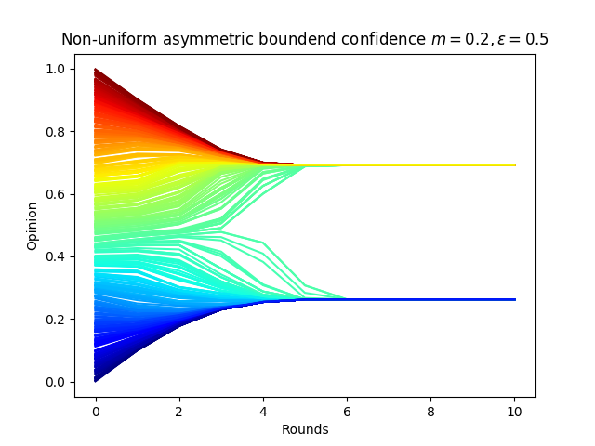
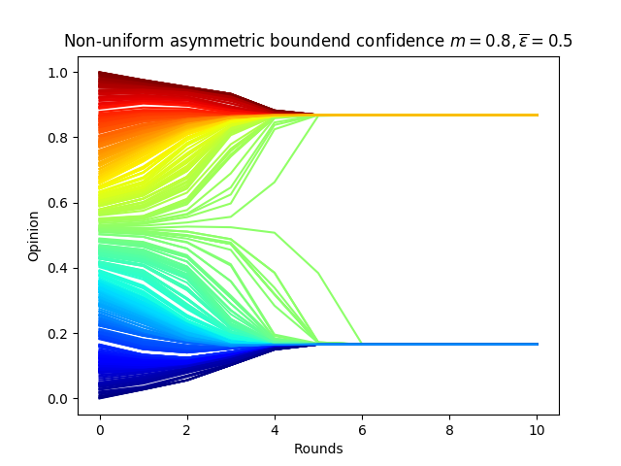
Simulation - Opinion dependent asymmetry
m = 0 , ⋶ = 0.5
m = 0.2 , ⋶ = 0.5
m = 0.8 , ⋶ = 0.5

Slide 30
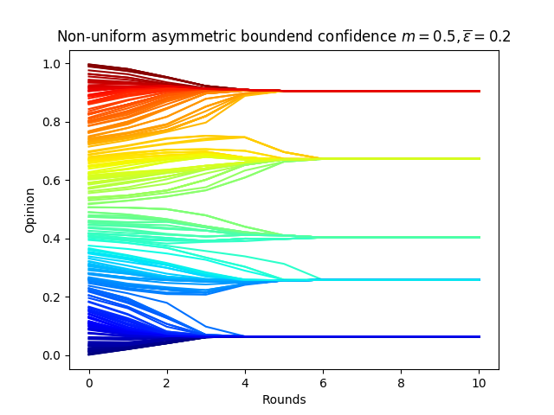
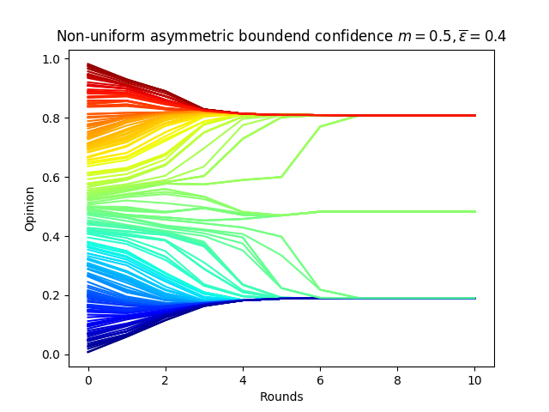
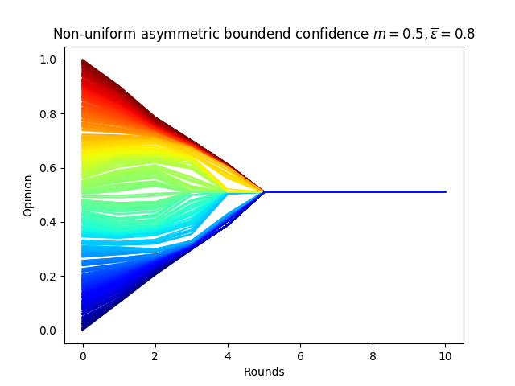
Simulation - Opinion dependent asymmetry
m = 0.5 , ⋶ = 0.2
m = 0.5 , ⋶ = 0.4
m = 0.5 , ⋶ = 0.8

Slide 31
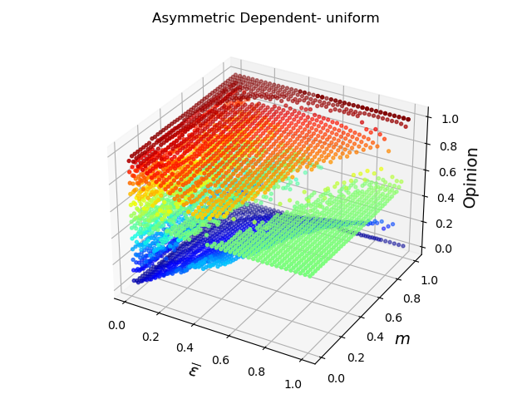
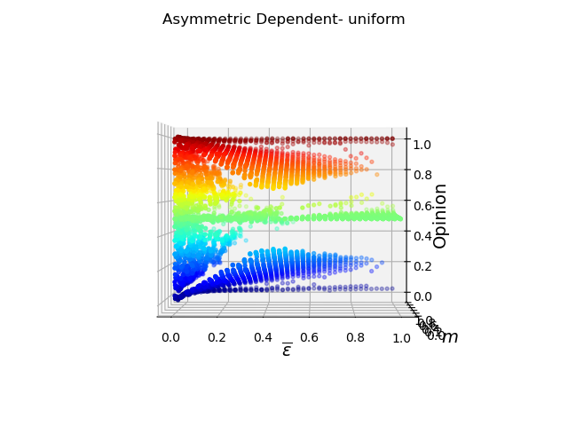
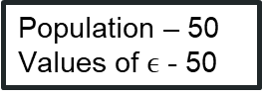
Bifurcation - Asymmetric Dependent and Uniform
Population – 50
Values of $ϵ$ - 50
Opinion dependent intervals almost always create polarization!

Slide 32
Outline
Introduction
Classical Model
Bounded Confidence Model
Co-evolution Network
Discussion and Conclusion

Slide 33
Motivation
Despite random initial distribution, previous models are “quite” deterministic during the process.
Taking probabilities into the process → Monte Carlo methods.
Voting behaviors, as are usually social fields, are of stochastic nature.

Slide 34
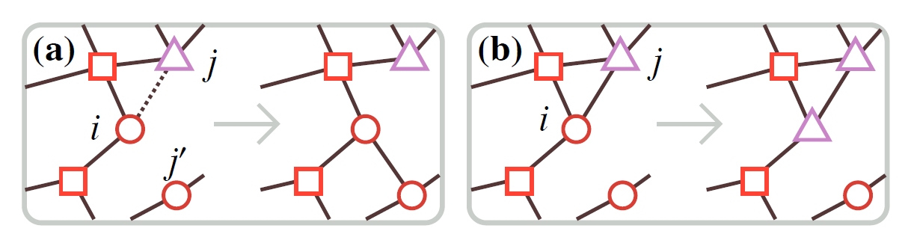
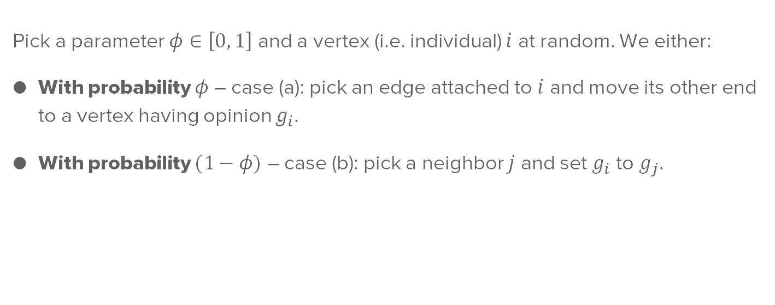
Co-evolution network
Pick a parameter $φ∈\left[0, 1\right]$ and a vertex (i.e. individual) $i$ at random. We either:
With probability $φ$ – case (a): pick an edge attached to $i$ and move its other end to a vertex having opinion $g_{i}$.
With probability $(1−φ)$ – case (b): pick a neighbor $j$ and set $g_{i}$ to $g_{j}$.

Slide 35
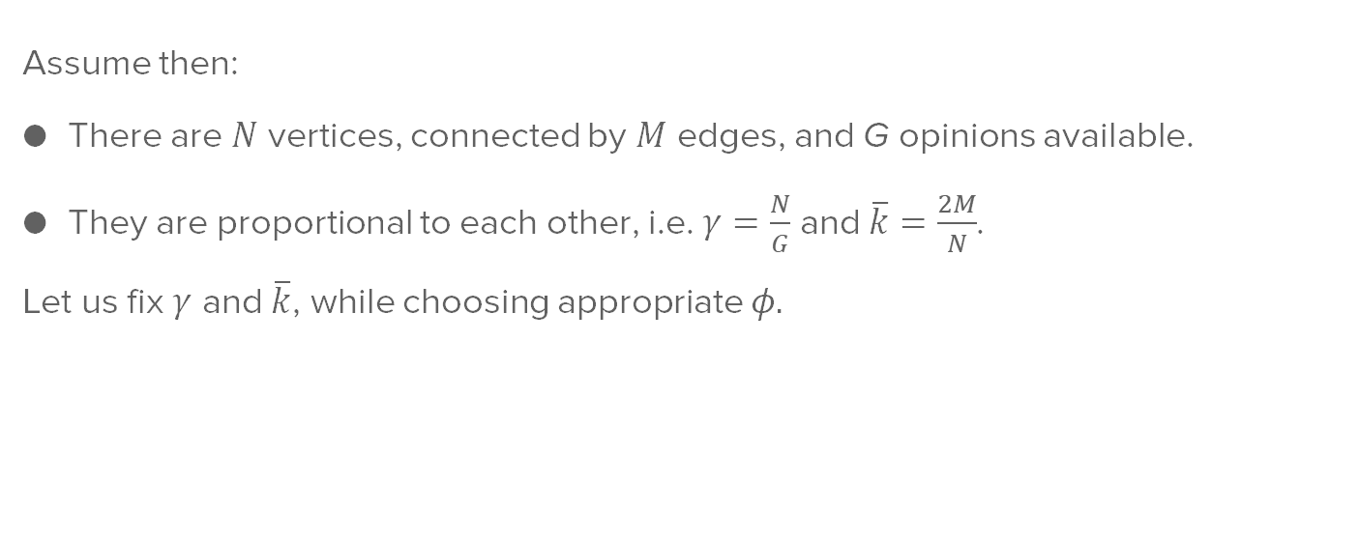
Co-evolution network
Assume then:
There are $N$ vertices, connected by $M$ edges, and G opinions available.
They are proportional to each other, i.e. $γ=\frac{N}{G}$ and $\overline{k}=\frac{2M}{N}$.
Let us fix $γ$ and $\overline{k}$, while choosing appropriate $φ.$

Slide 36
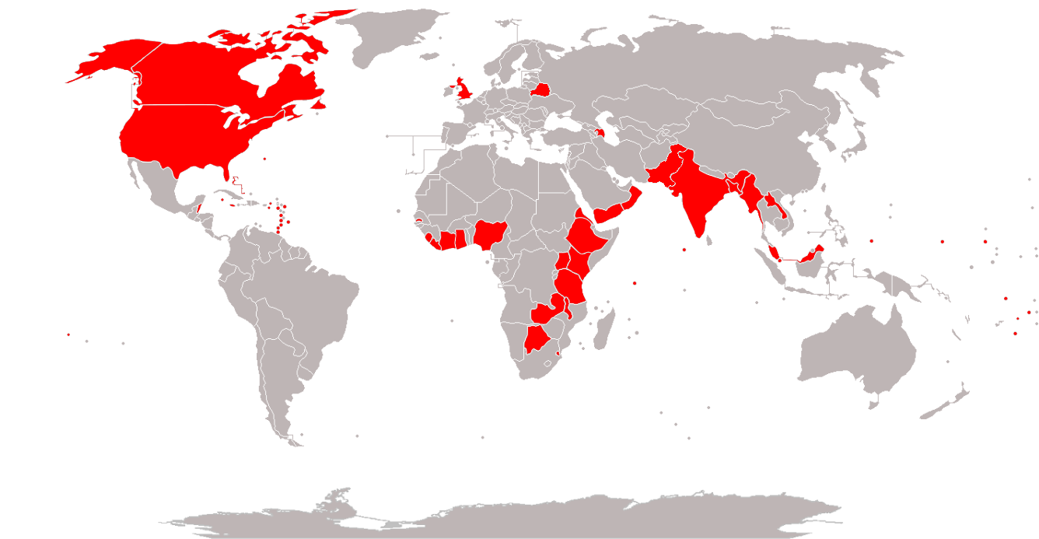
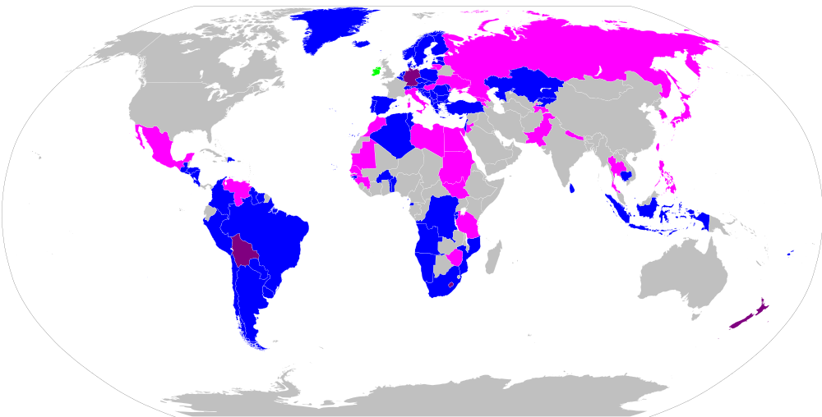
Application: Voting schemes
First-past-the-post Proportional representation
Source: Wikipedia, downloaded on 06.12.2020.

Slide 37


Application: Voting schemes
Both schemes can be modeled by co-evolution network.
Proportional representation: case (a) → choose large $φ$.
First-past-the-post: case (b) → choose small $φ$ and set
$g_{i}$ to $g_{j}$ if joint probability satisfied: $φ_{1}=\frac{5/3}{\left|g_{j}−g_{i}\left(t=0\right)\right|} ⋂ φ_{2}=f\left(k_{j}\right)$, where $f$ follows $𝒩\left(\frac{M}{2},M×0.3\right)$.
Repeat with a new $j$ until satisfied.

Slide 38



Simulation
Setting $N=100$, $γ=10$ and $\overline{k}=4$, with opinions distributed uniformly at $t=0$.
First-past-the post - $φ=0,25$ Proportional representation - $φ=0,75$

Slide 39

Simulation
Setting $N=100$, $γ=10$ and $\overline{k}=4$, with opinions distributed uniformly at $t=0$.
First-past-the post - $φ=0,25$ Proportional representation - $φ=0,75$

Slide 40
Outline
Introduction
Classical Model
Bounded Confidence Model
Co-evolution Network
Discussion and Conclusion

Slide 41
Conclusion
Coevolution Network
Classical
Opinion Dynamics
Bounded Confidence

Slide 42


Conclusion
Tendency to mean
Classical
Image taken from Lorenz, J. (2017). Repeated Averaging and Bounded Confidence Modeling , Analysis and Simulation.
Models based on qualitative experimental data!
Ignore if difference in opinions high
Bounded Confidence
Image taken from Moussaïd, M., Kämmer, J. E., Analytis, P. P., & Neth, H. (2013). Social influence and the collective dynamics of opinion formation. PLoS ONE, 8(11)

Slide 43
Conclusion
Bounded Confidence
Coevolution Network
Classical
Simple but flexible
Foundational to the field
Inspired on known psychological phenomena
Always tends to consensus
Fixed network interactions
Continuous opinion
Consensus | ✓
Clustering | ✓
Polarization | ✗

Slide 44
Conclusion
Bounded Confidence
Coevolution Network
Classical
‘KISS-principle: Keep it simple, stupid!’ [1]
Based on confirmation bias
Finds polarization even when all agents interact (Asymmetry dependent)
Wide array of modifications that build on first principles
Robust to noise
All agents interact with each other
Equal weight on own opinion
Continuous opinion
Consensus | ✓
Clustering | ✓
Polarization | ✓
[1] Hegselmann, R., & Krause, U. (2002). Opinion dynamics and bounded confidence: Models, analysis and simulation. Jasss, 5(3).

Slide 45
Conclusion
Bounded Confidence
Coevolution Network
Classical
Dynamic network
Discrete opinions
Can’t reproduce polarization
Consensus | ✓
Clustering | ✓
Polarization | ✗

Slide 46
Q&A

